Slide 1

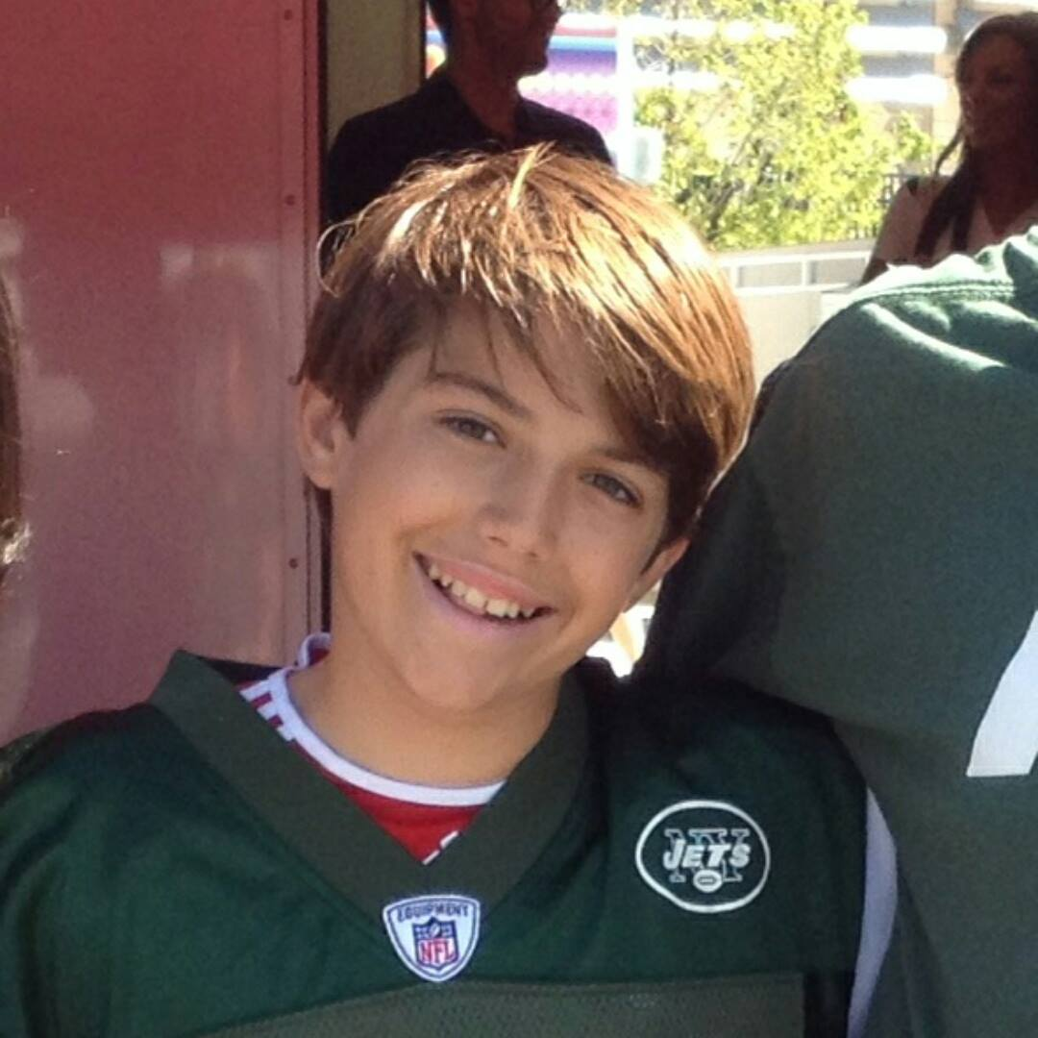
Mobile Application Development
Mamaroneck High School
Andrew Katz
Lead Developer
10th Grade Student
Mamaroneck High School
aakatz3@gmail.com
Sam Brause
Assistant Developer
9th Grade Student
Mamaroneck High School
svbrause@gmail.com
Notes:
A: Hello, I’m Andrew Katz
S: And I’m Sam Brause. We are from Mamaroneck High School, and we are here to present our solution to the mobile application development competition.

Slide 2
Our school has asked us to write a mobile application announcing activities at our school including dates, times, and contact information. We were to include an events list, and a banner with images.
Notes:
A: We were asked by our school to write a mobile App that announces events at our school, including dates, times, and contact information.
S: We were to package an events list with the app, and include a banner of images.

Slide 3
Our Solution
The front page of the app has a banner of images
The front page has a list of events
When an event is clicked on, it is brought up in more detail
The details view allows emailing the organizer (if available), sharing the event, and adding to calendar.
Notes:
A: Our app addresses each aspect of the task.
S: Our app’s main screen is an events list, and it has a banner of images from our school’ website.
A: When an event is clicked on, the details view is opened, allowing the user to preform multiple actions, including emailing the event organizer, if available.

Slide 4
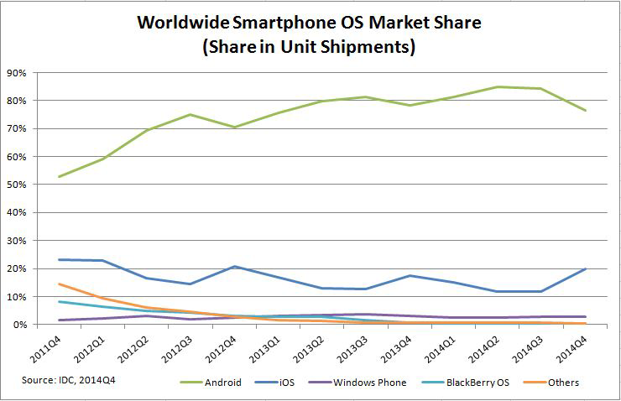
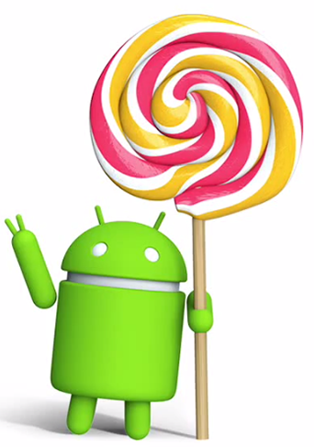
Why android?
Notes:
A: We chose to write our app for the android platform because, International Data Corporation’s survey found android to be the most prevalent smartphone os.

Slide 5
Design Process
Interface Design
Implement Basic Functionality
Debug
Expand Functionality
Debug
Testing
Release
Notes:
S: We followed a seven step design process, beginning with designing our user interface and ending with the release of our app.
A: As we followed this process, we documented the app.

Slide 6
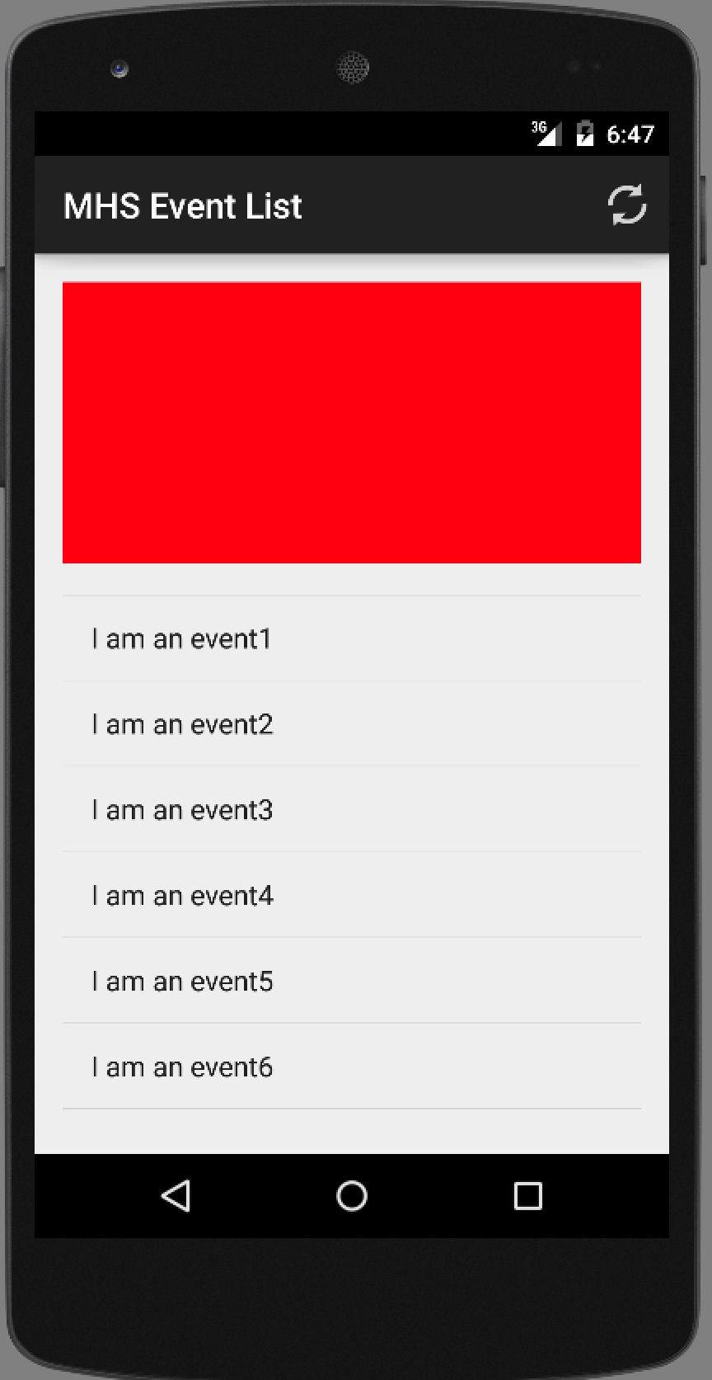
Design Process
Interface Design
Implement Basic Functionality
Debug
Expand Functionality
Debug
Testing
Release
Notes:
A: The first step was to design the basic user interface in Android Studio

Slide 7
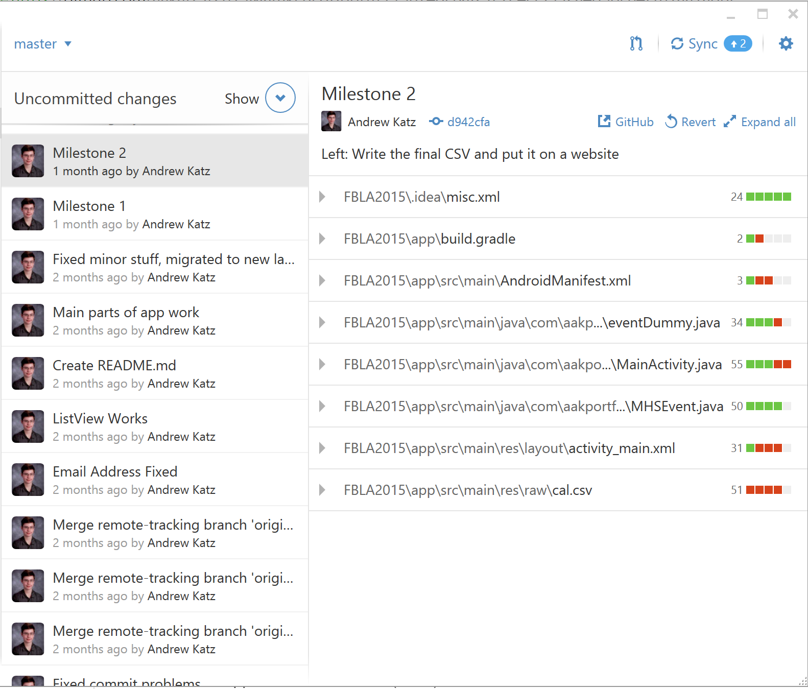
Design Process
Interface Design
Implement Basic Functionality
Debug
Expand Functionality
Debug
Testing
Release
Notes:
S: Next, we implamented the code behind the interface, to create a basic, functional app.

Slide 8
Design Process
Interface Design
Implement Basic Functionality
Debug
Expand Functionality
Debug
Testing
Release
Notes:
S: We then debugged our code.

Slide 9
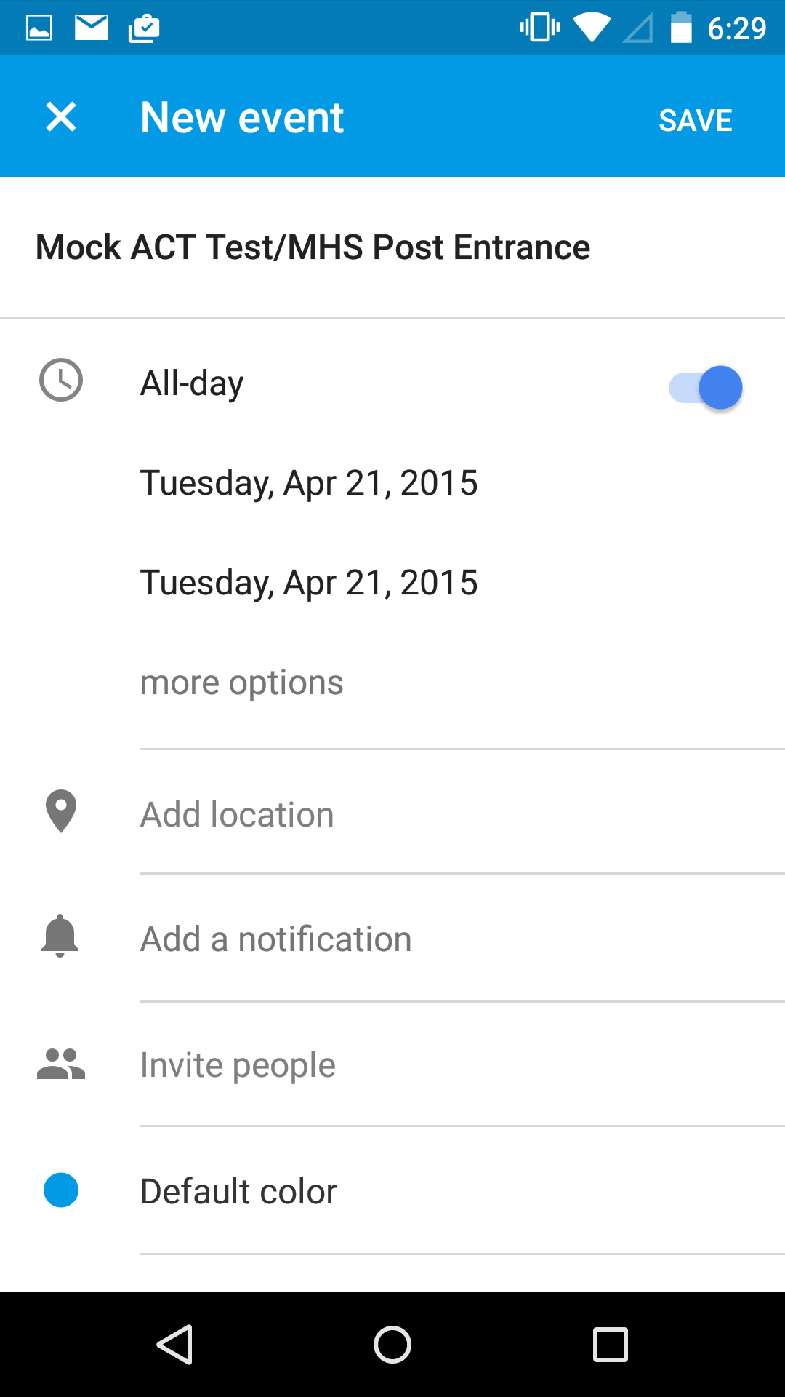
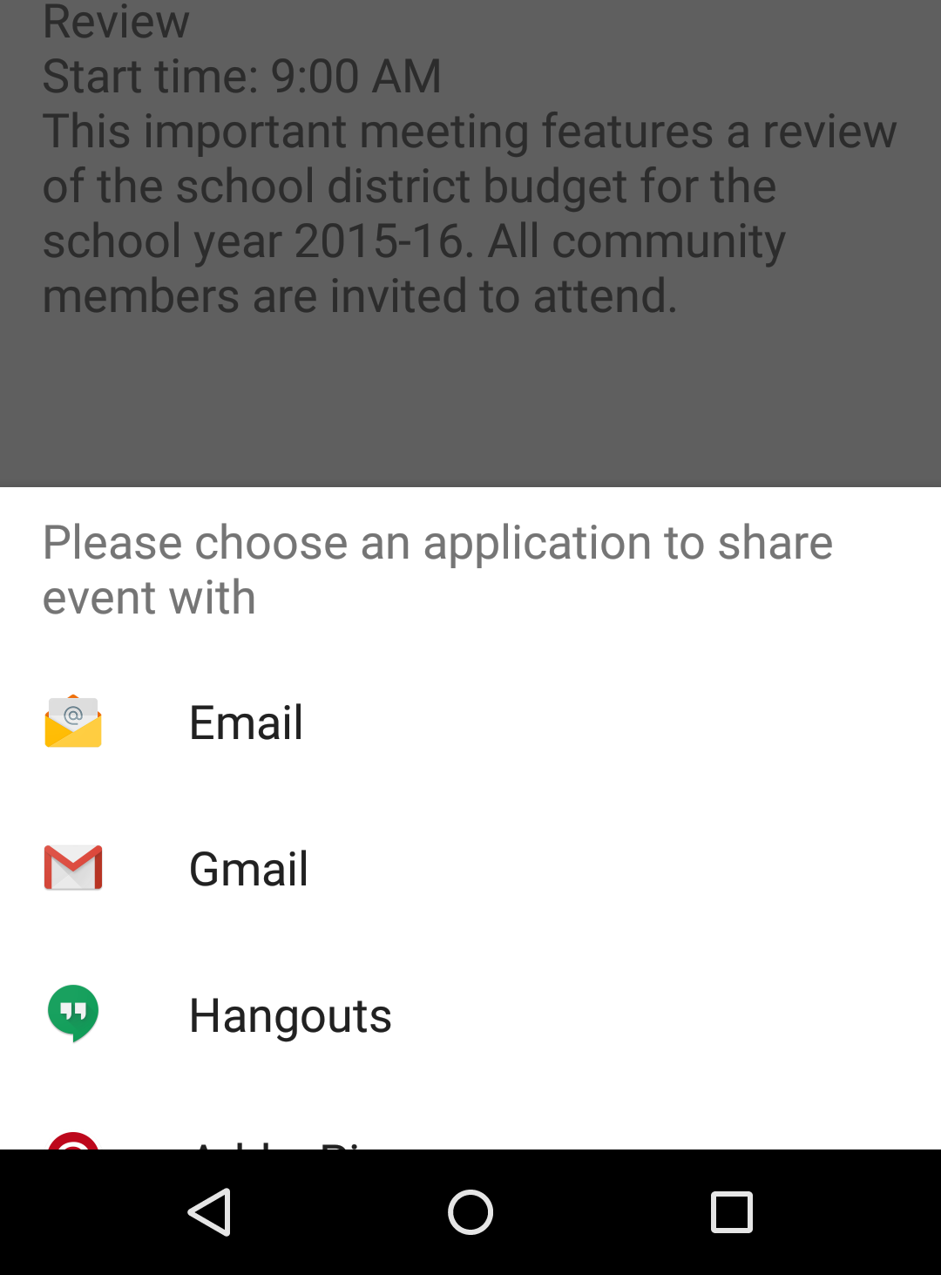
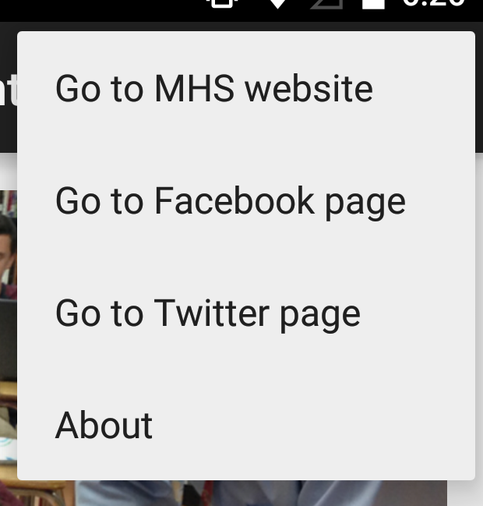
Design Process
Interface Design
Implement Basic Functionality
Debug
Expand Functionality
Debug
Testing
Release
Notes:
A: We continued expanding the functionality of the app to go beyond the requirements, and improve the design.

Slide 10
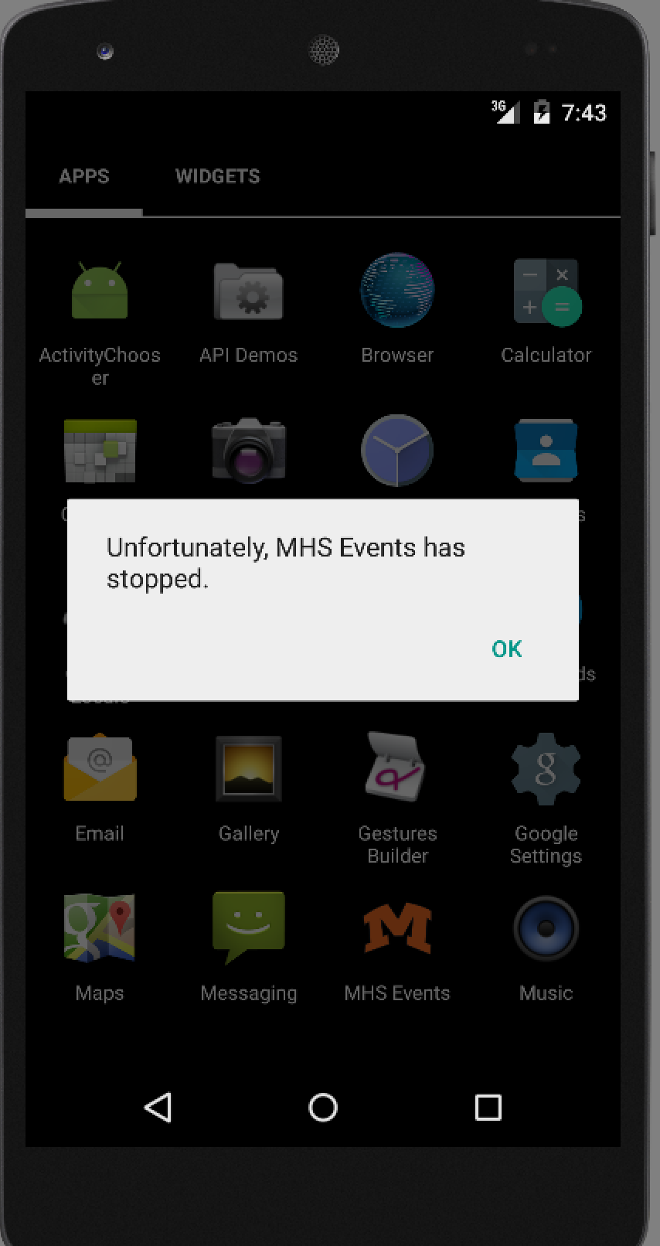
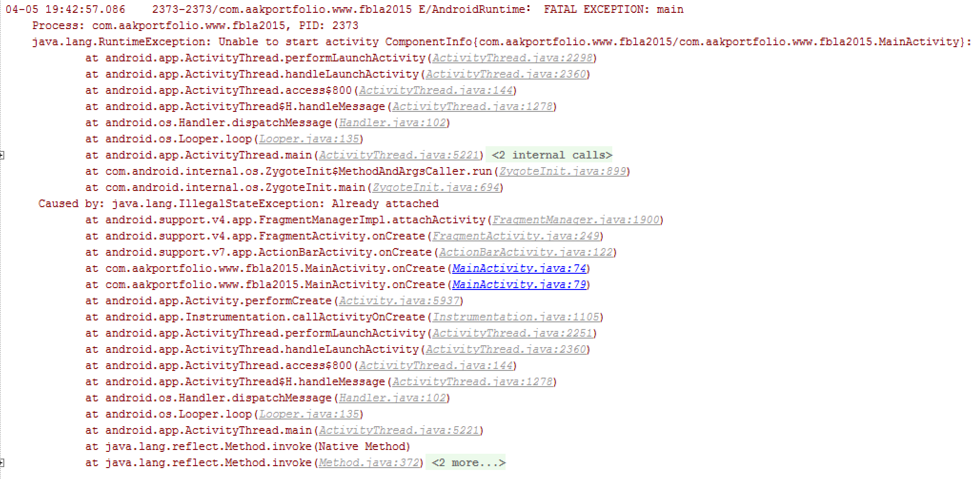
Design Process
Interface Design
Implement Basic Functionality
Debug
Expand Functionality
Debug
Testing
Release
Notes:
A: We then had to debug the app again.

Slide 11
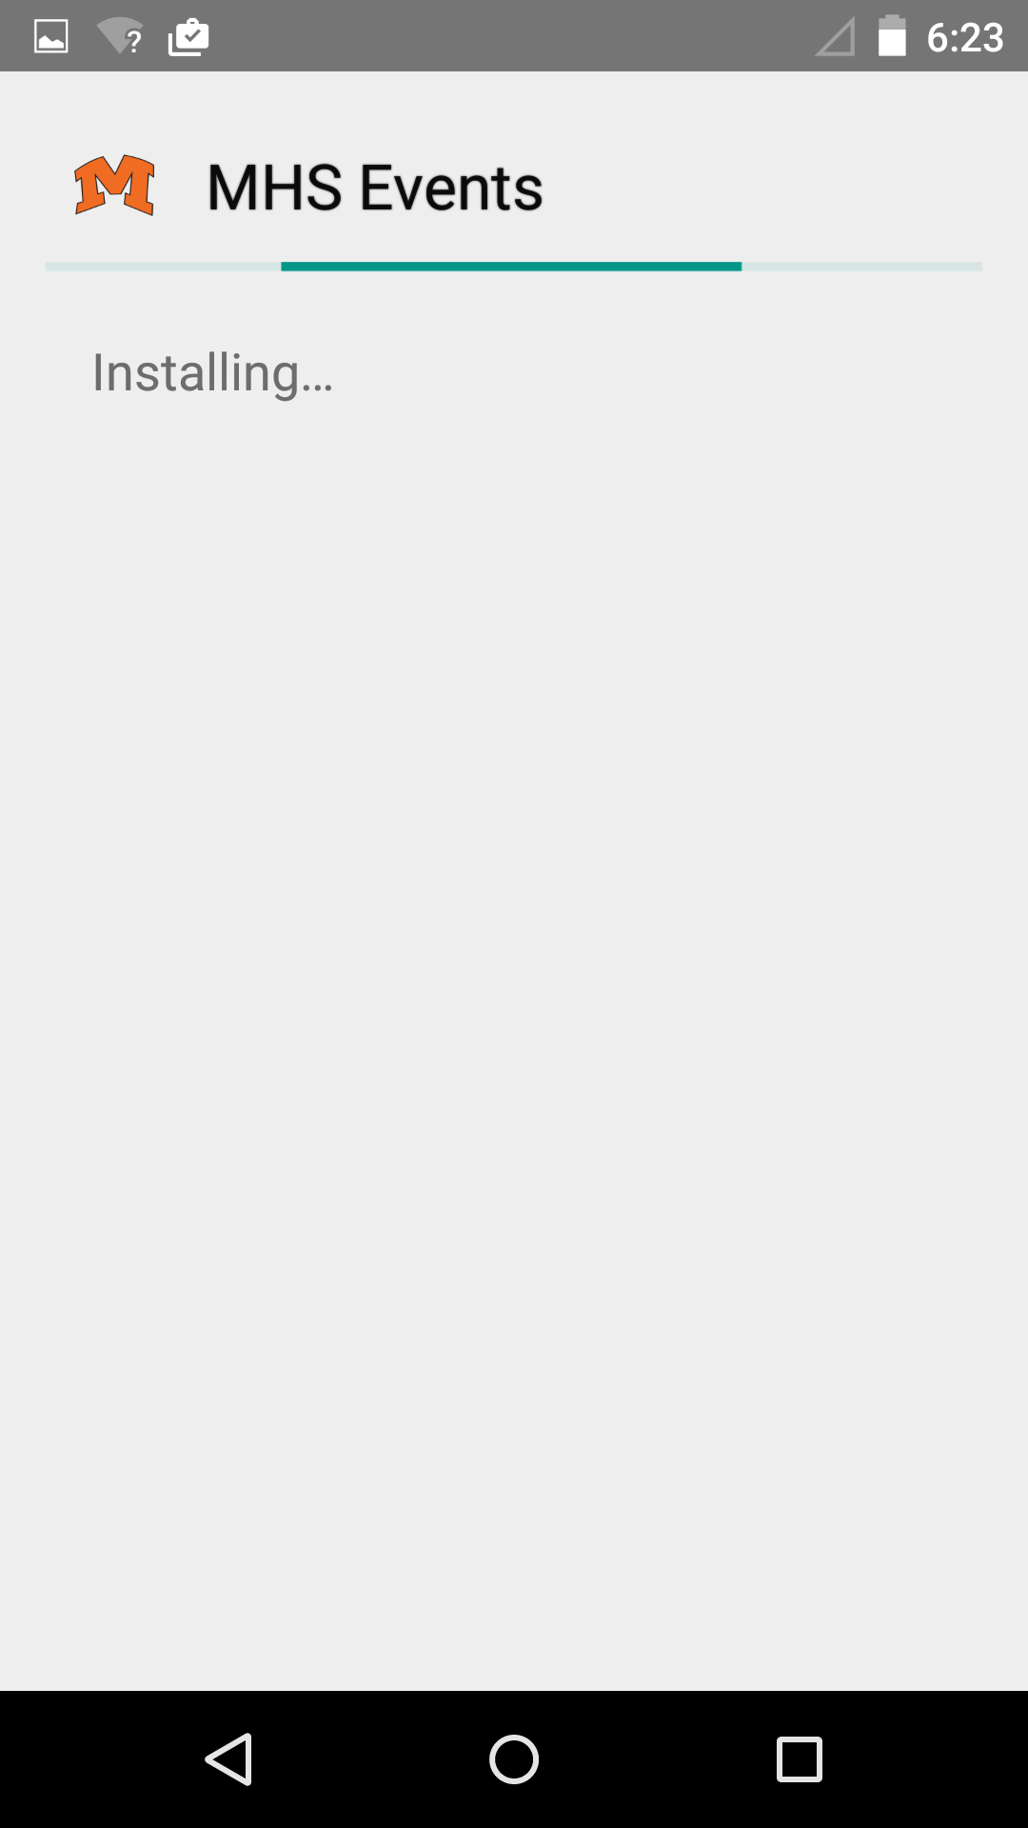
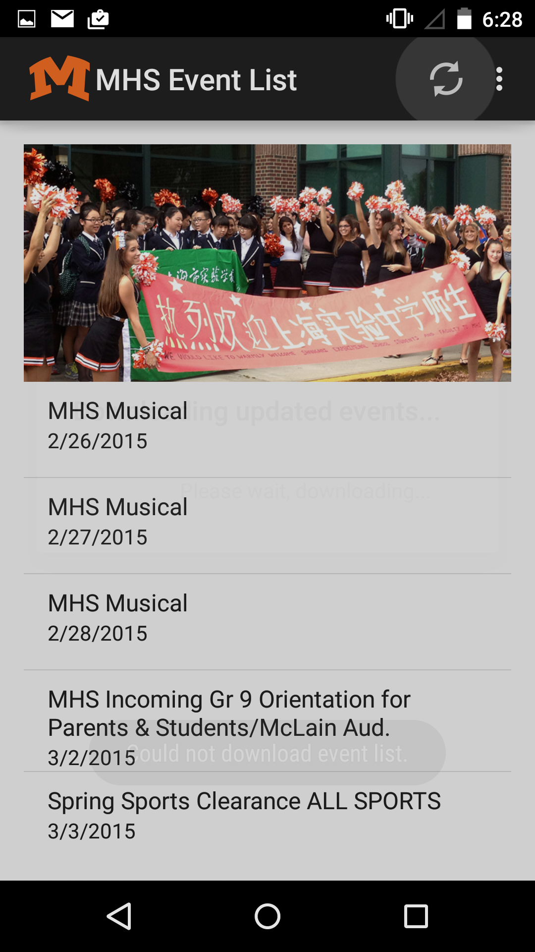
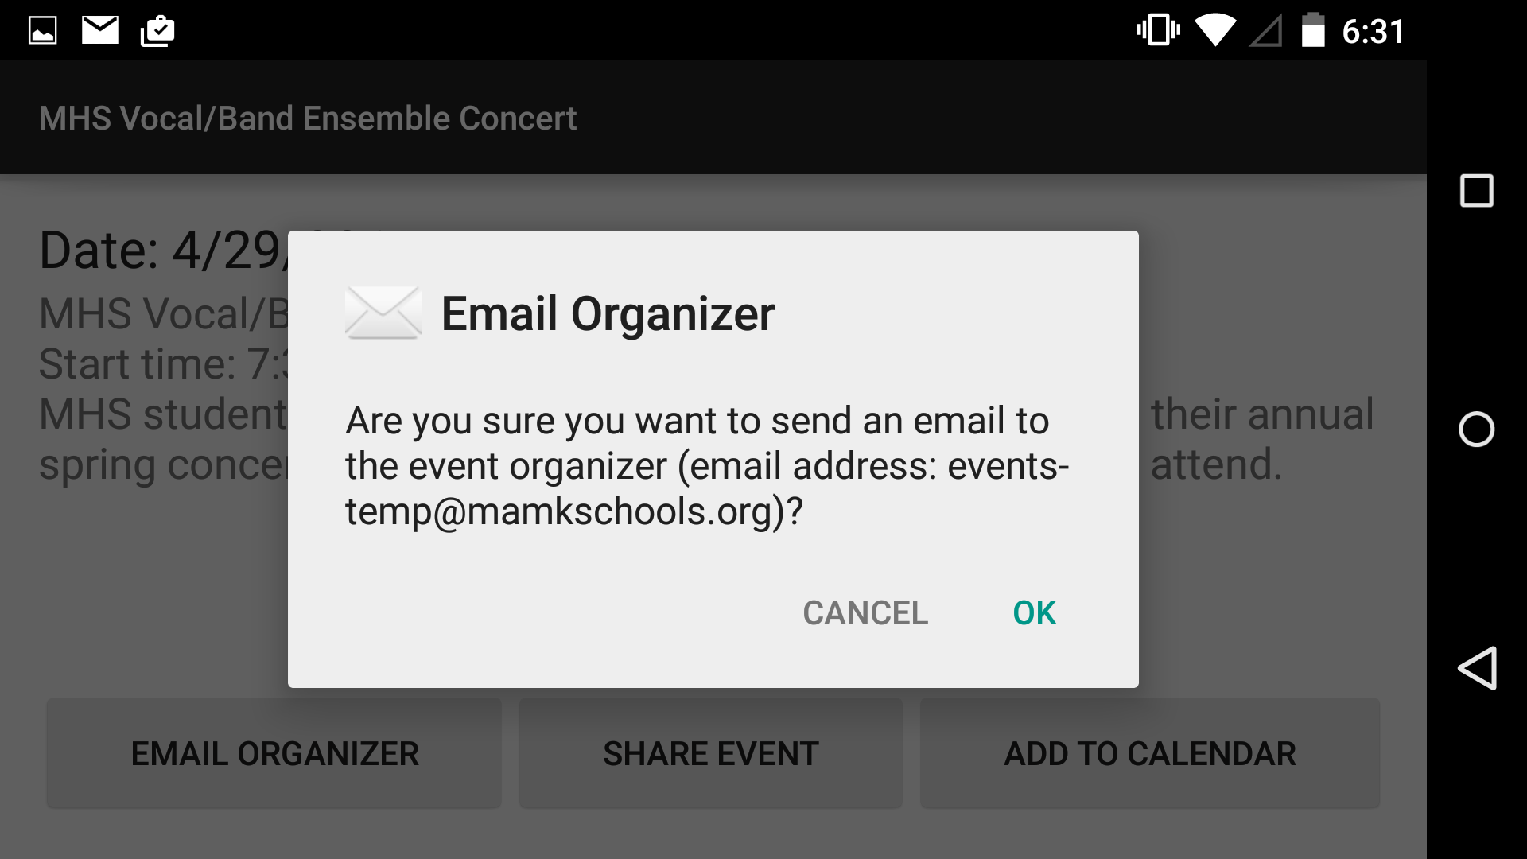
Design Process
Interface Design
Implement Basic Functionality
Debug
Expand Functionality
Debug
Testing
Release
Notes:
S: Lastly, we had users test the app

Slide 12
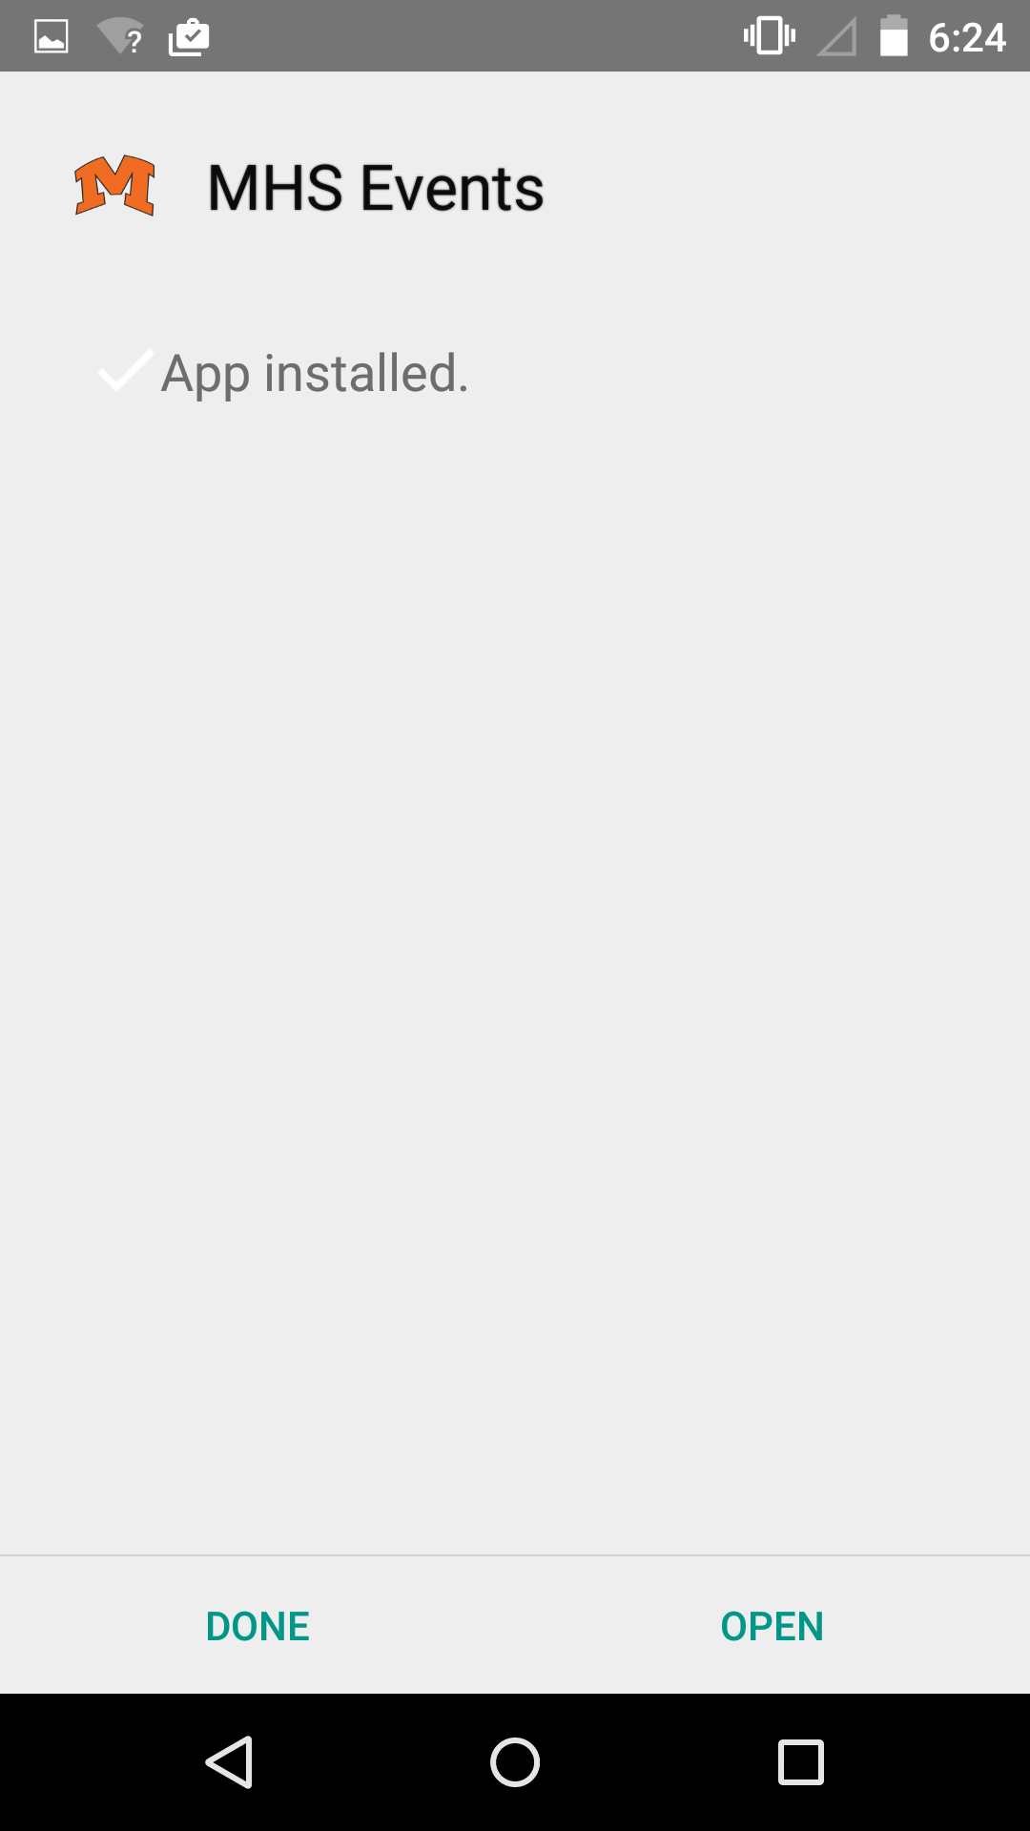
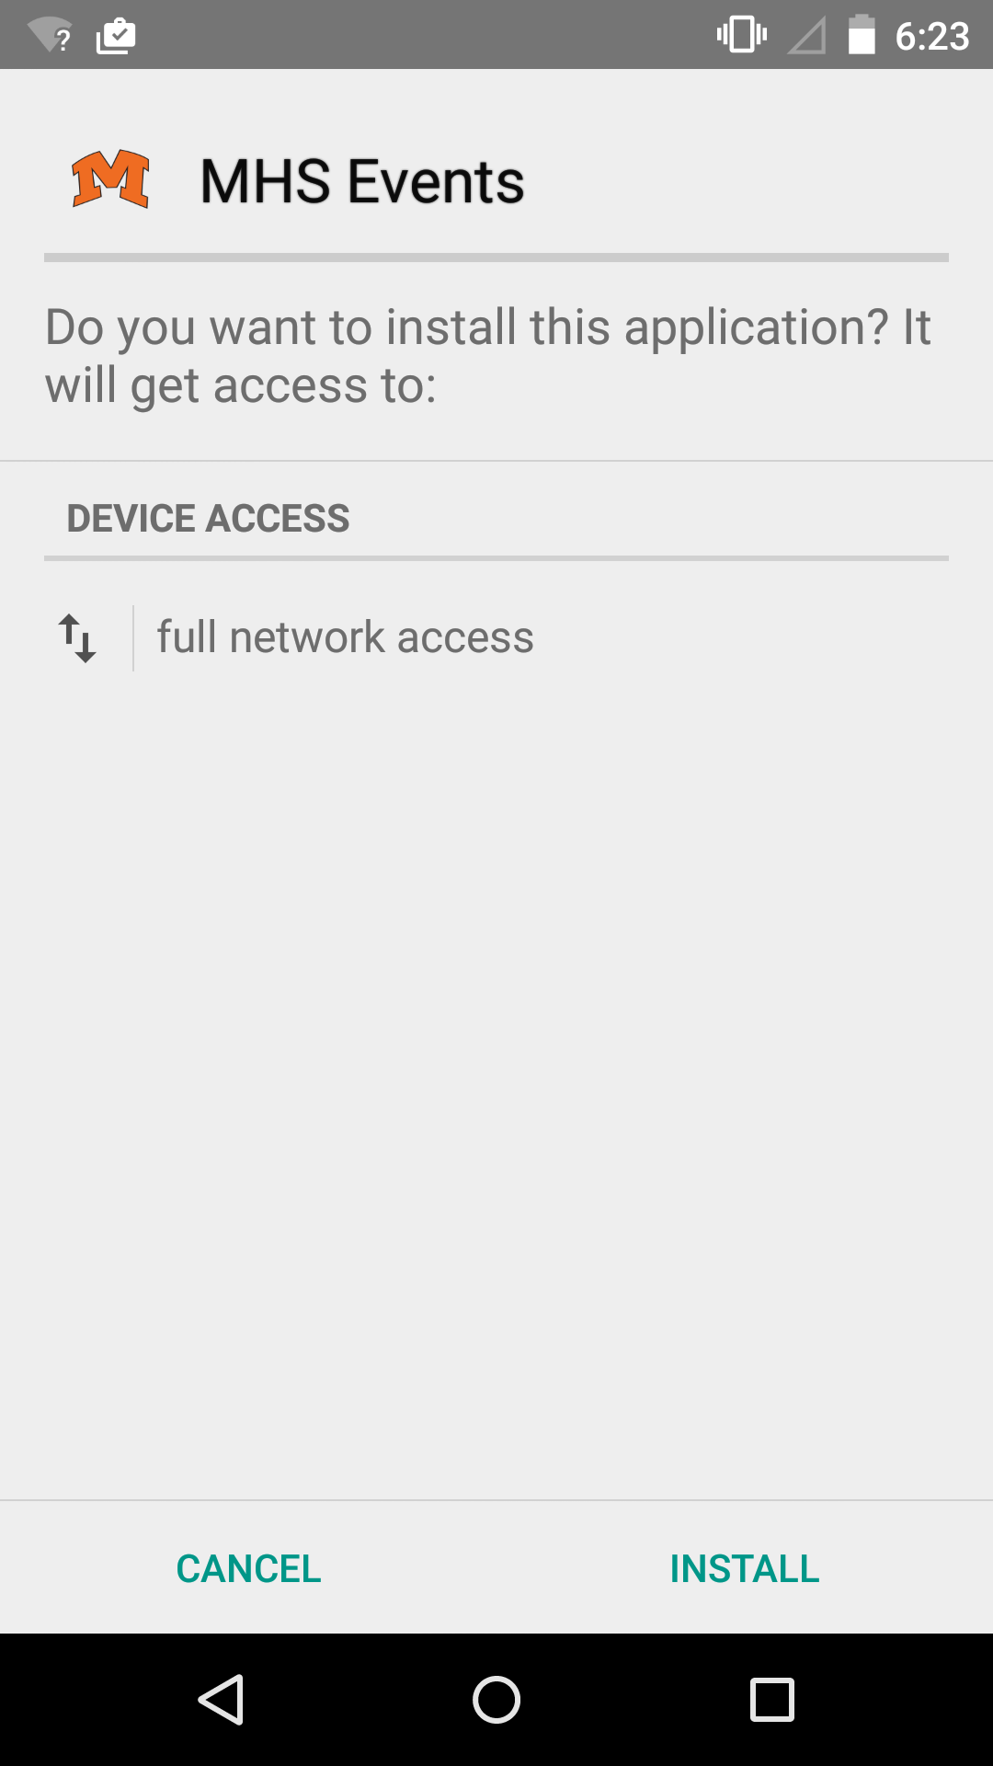
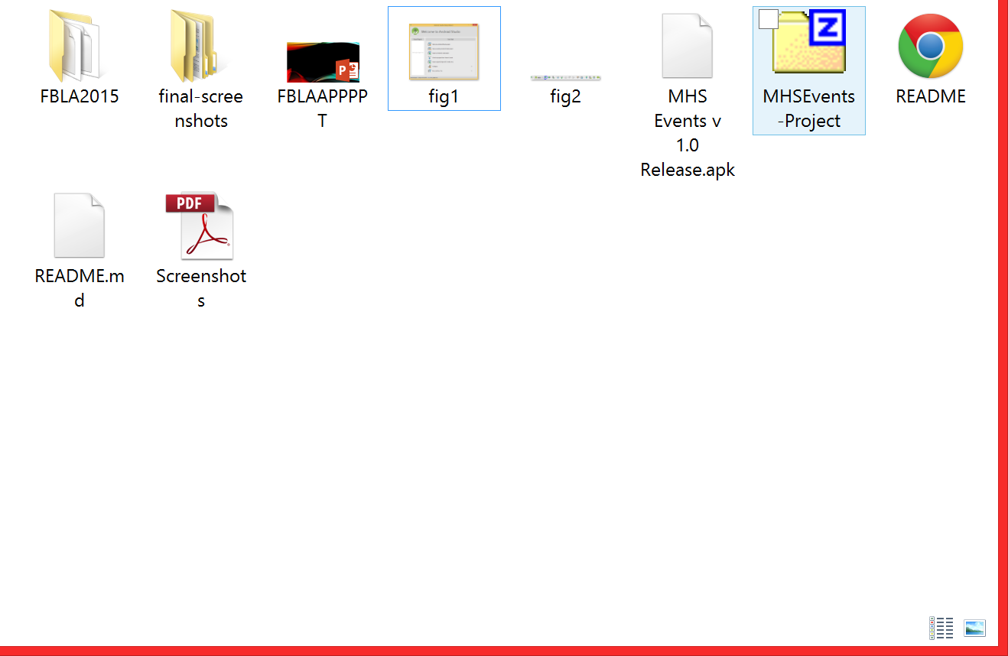
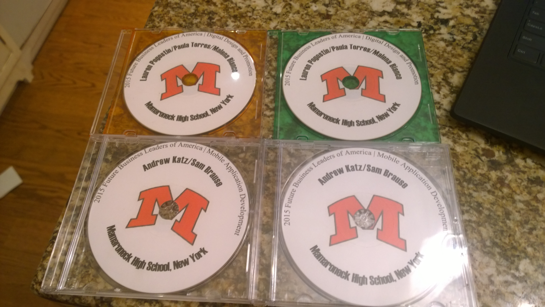
Design Process
Interface Design
Implement Basic Functionality
Debug
Expand Functionality
Debug
Testing
Release
Notes:
A: After we finished our app, we packaged the app along with our documentation, and submitted it for review on 2 DVDs

Slide 13



Tools Used
Android Studio
Github
Microsoft Word
Notes:
S: We used three tools: Android Studio for designing the app, Github for collaboration and version control, and Microsoft Word for writing the additional documention.

Slide 14
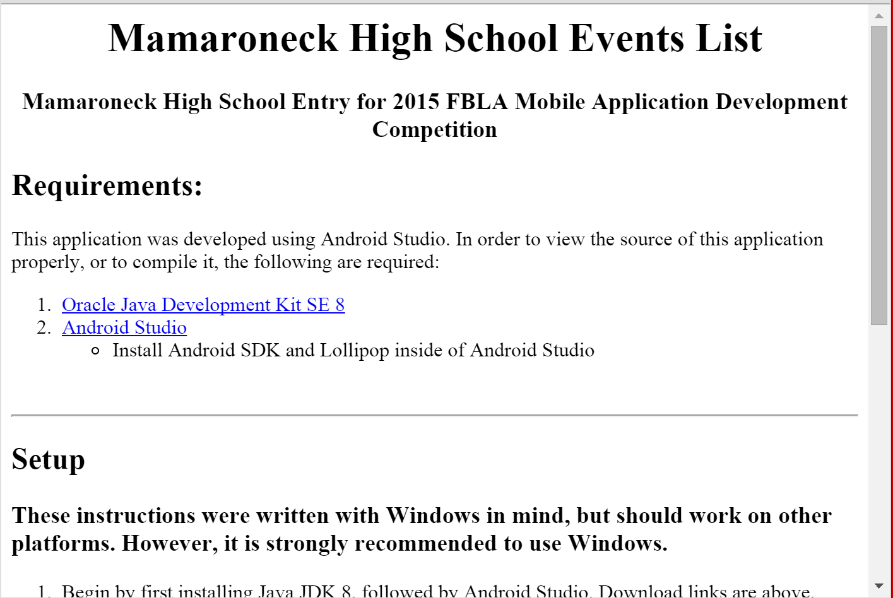
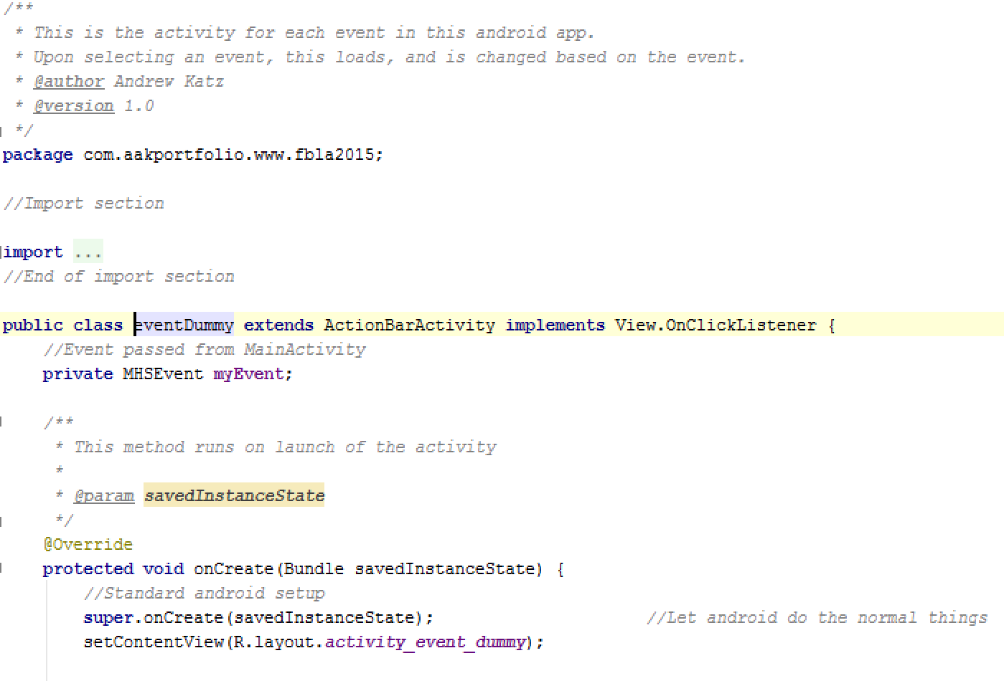
Documentation
Overall Documentation:
Readme describing procedure for testing
PDF with screenshots
In-Code Documentation:
Class-level comments
Method Comments
Notes:
A: We wrote two different forms of documentation: Documentation that covered the entire app, including screenshots and instructions for testing, and documentation within the code, describing classes and methods.

Slide 15
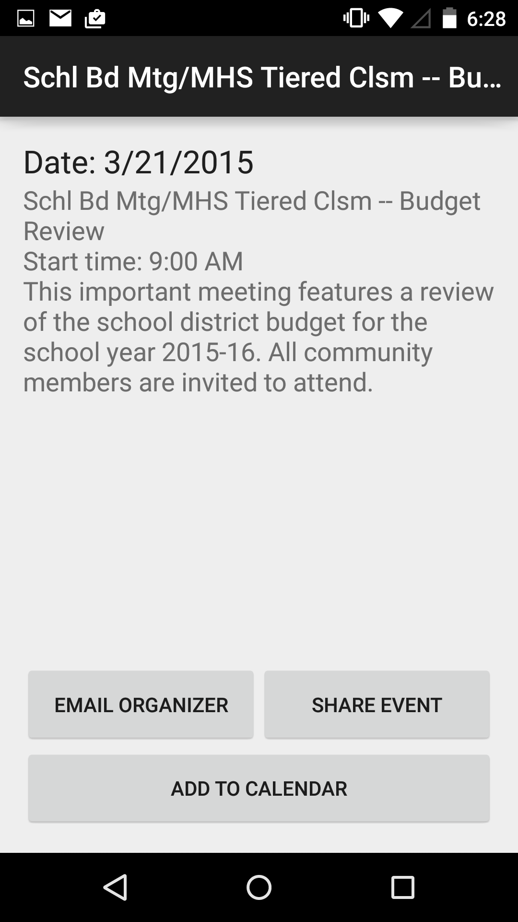
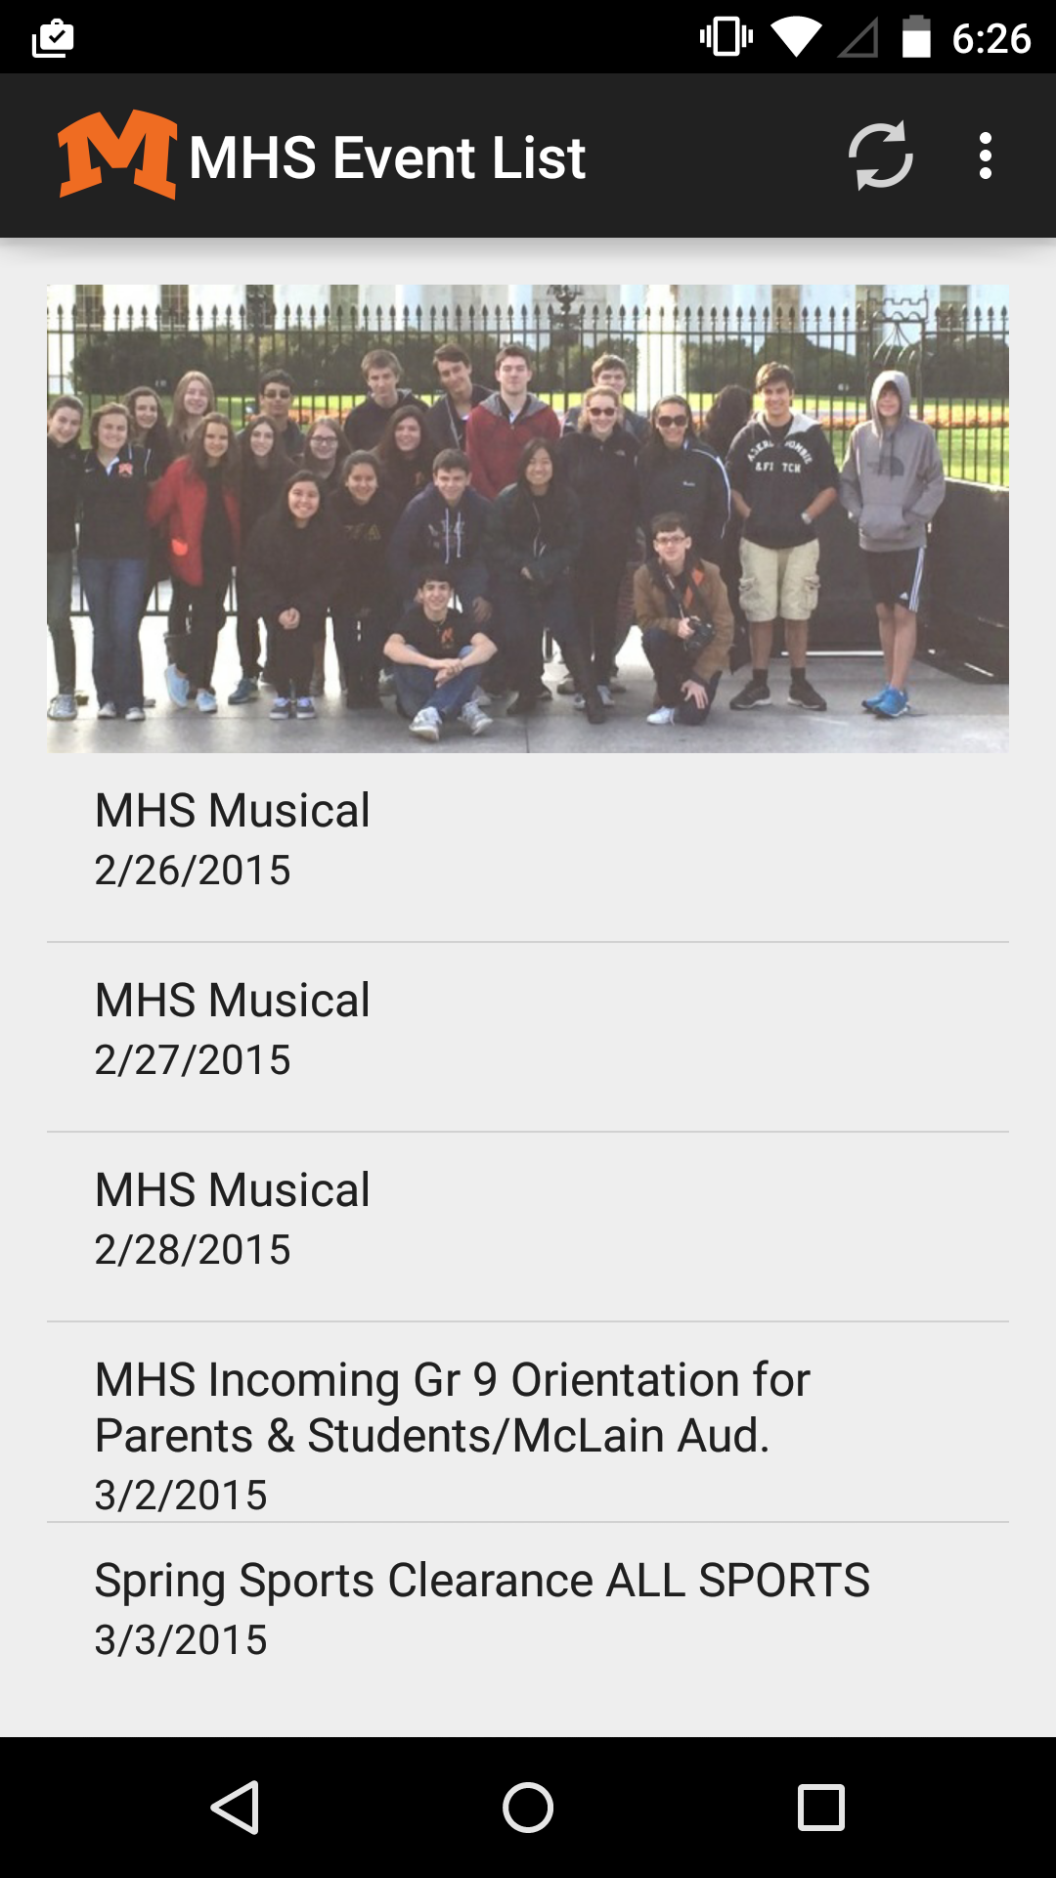
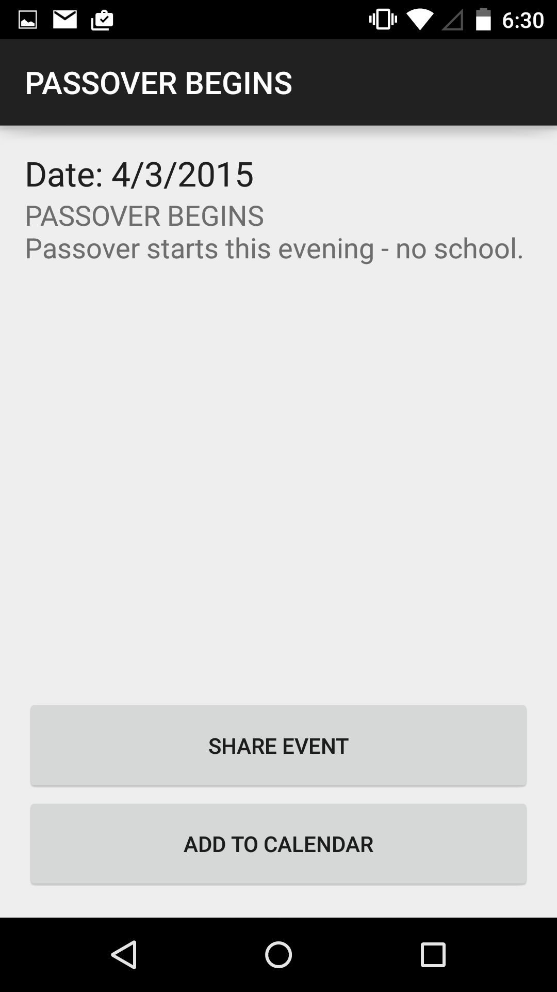
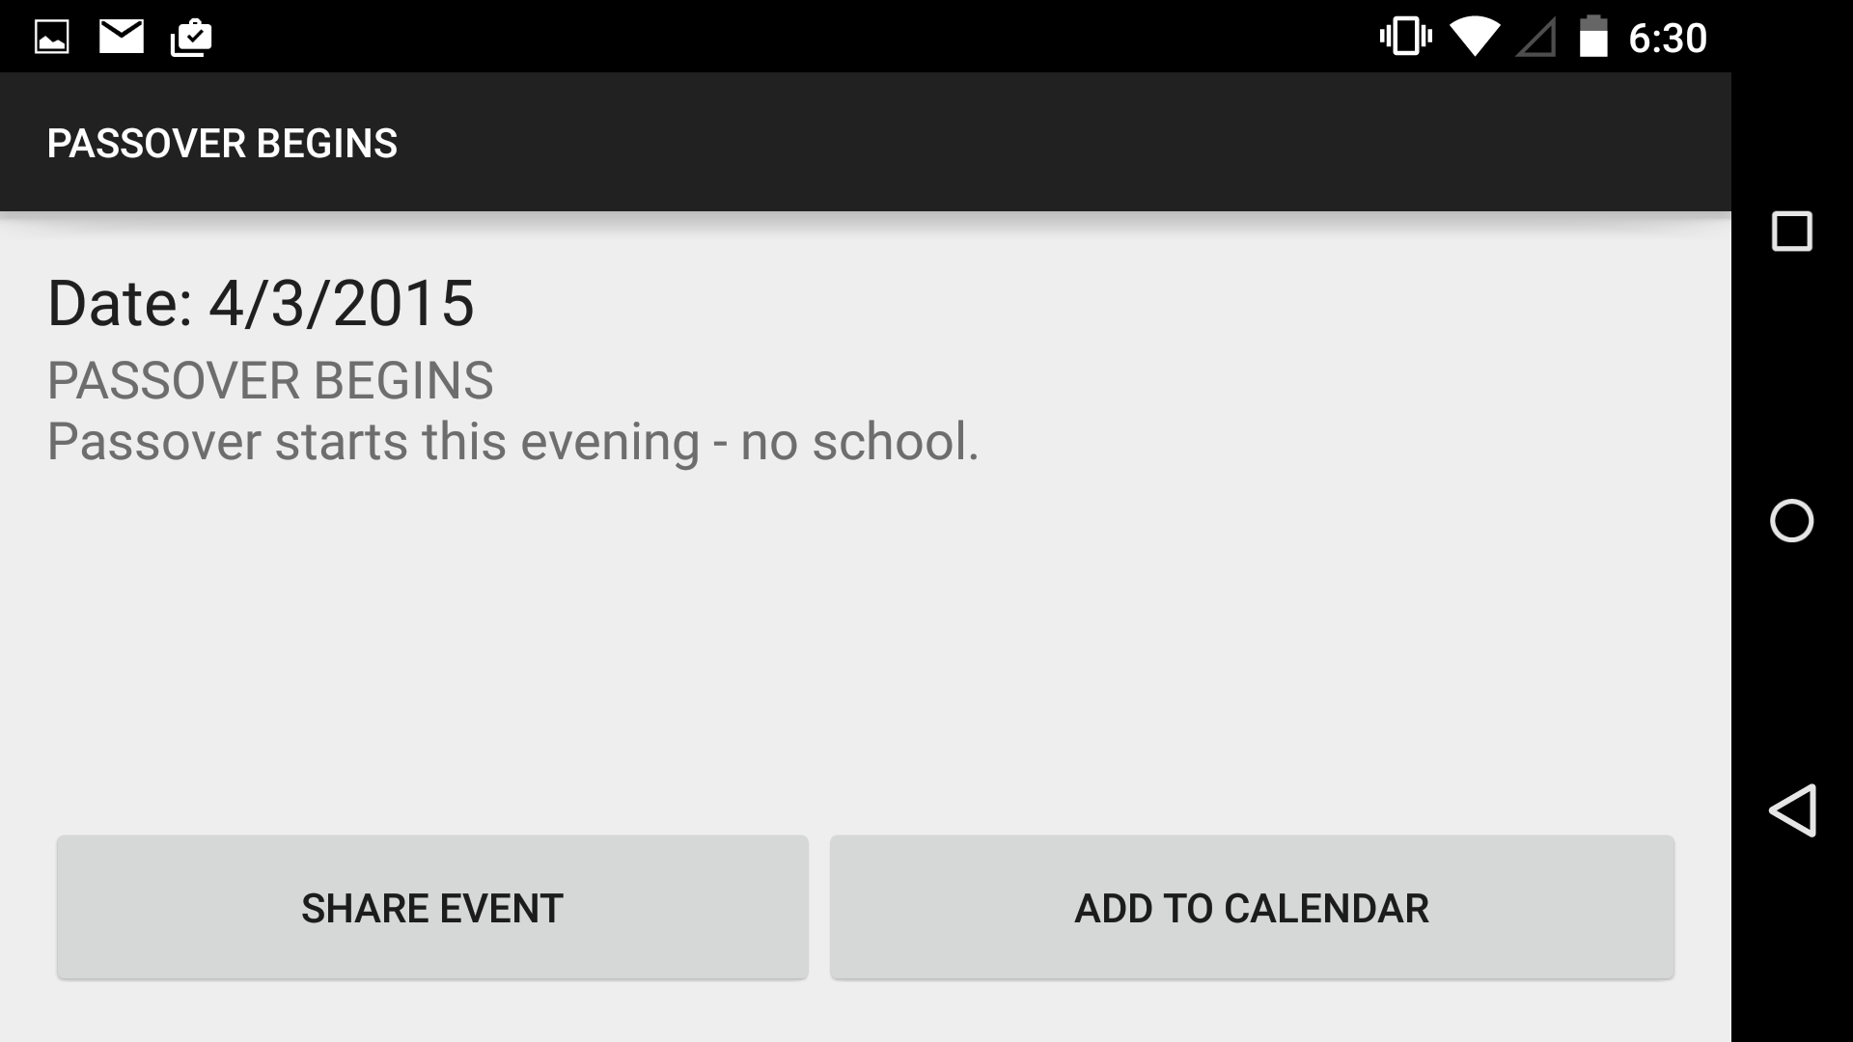
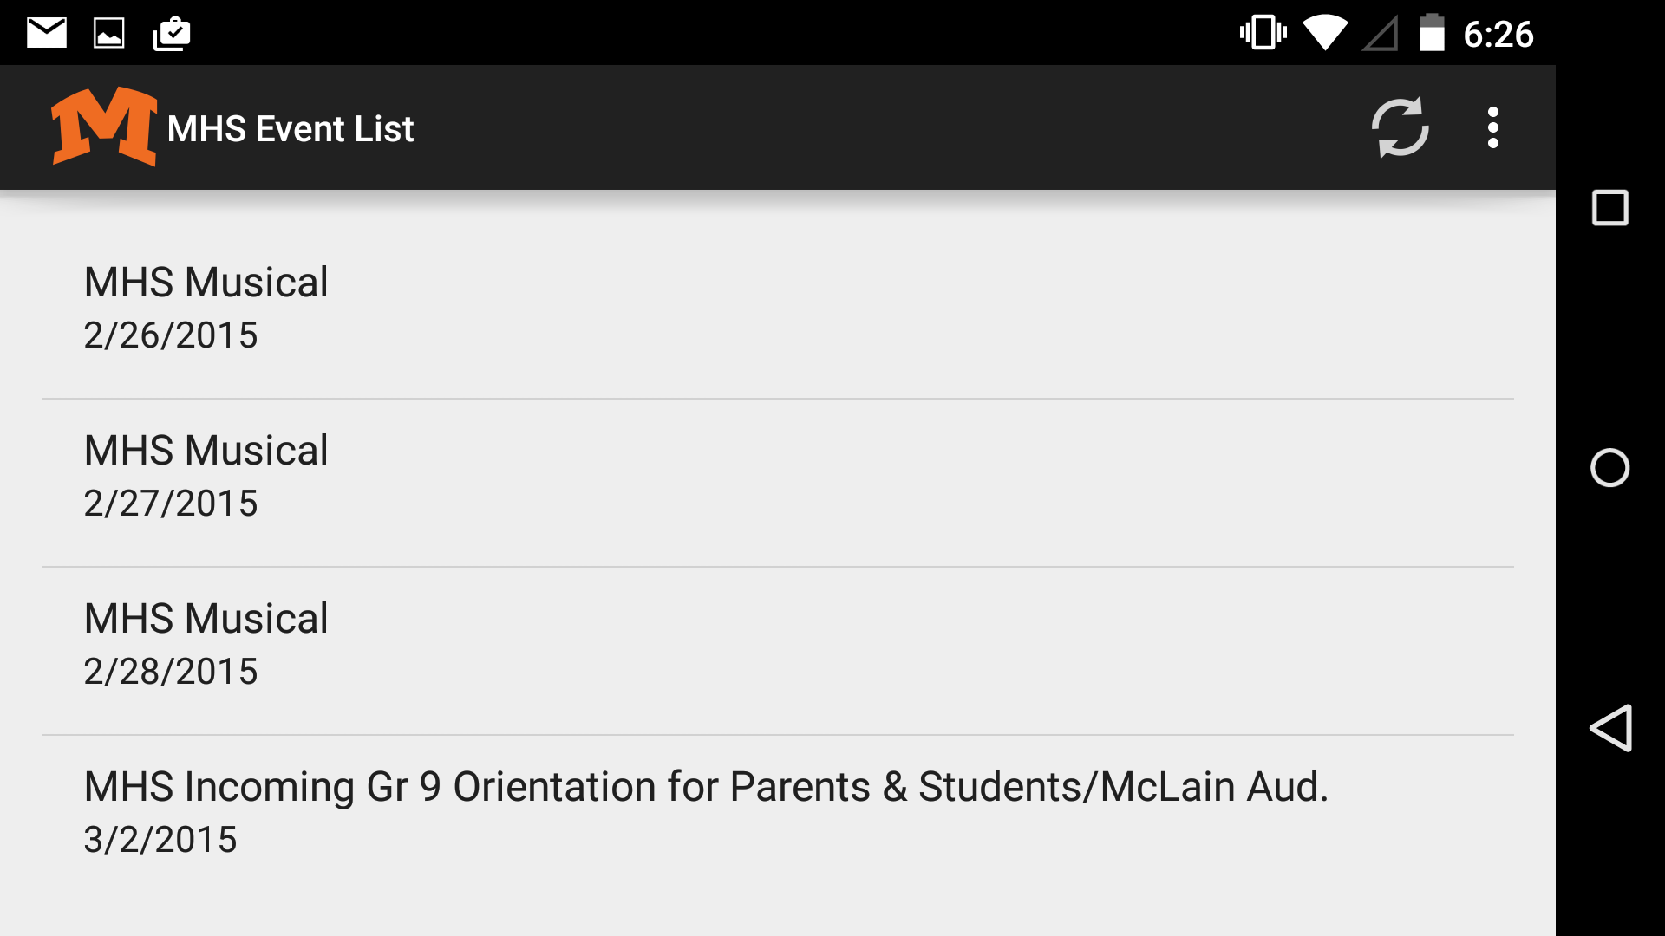
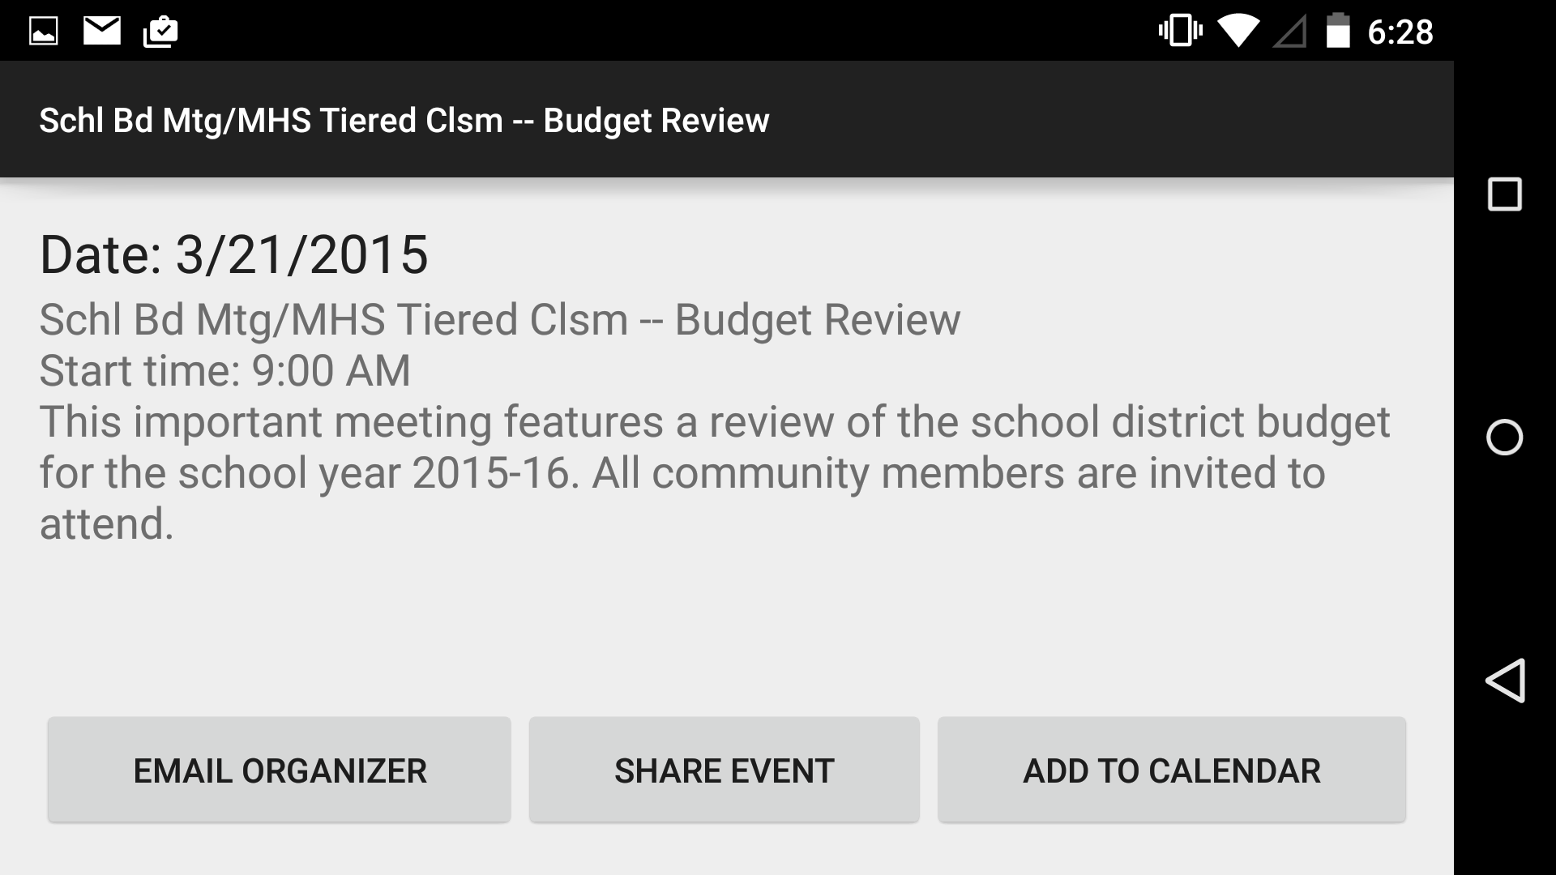

Screenshots
Notes:
S: Here is our app’s icon. We used our school’s logo as our app icon, to make it recognizable among the students.
[click]
A: This is the main screen of our app. Our app displays a list of events from a file included with the app. In portrait, a banner of images is also displayed.
[click]
S: When an event is clicked on, it is displayed in a more detailed view offering actions to the user.
[click]
A: Most events have an organizer, and with these events, a button is displayed allowing the user to contact the organizer.

Slide 16
Live Demo
Please wait a few seconds while we switch the projector to the phone…
Notes:
S: Please give us a moment

Slide 17
Thank you.
Are there any questions?
Notes:
A: Thank you very much for your time. We now open the floor to any questions.

